Slide 1
Distributed File System
CE7490 Group 7

Slide 2
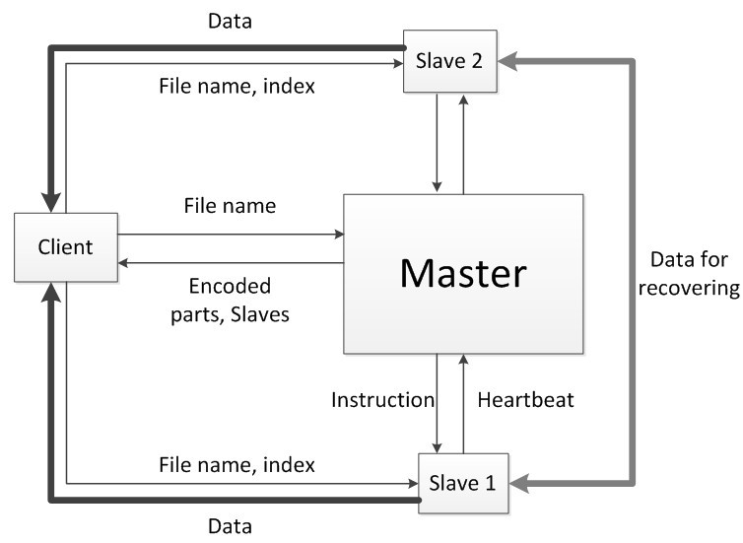
Architecture

Slide 3
Write Operation
Slave 1
Slave 2
Slave 3
Client
Master
…
Slave 8
Slave 9
Slave 10

Slide 4
Write Operation
Slave 1
Slave 2
Filename | Size | O1 | O2 | … | O1O2O3O4
hw.pdf | 21k | Slave 1 | Slave 7 | … | Slave 5
… | …. | … | … | … | …
prez.ppt | 120k | Slave 6 | Slave 5 | … | Slave 2
a.jpg | 100k | Slave 1 | Slave 10 | … | Slave 2
Slave 3
Write file “a.jpg”
size 100k
…
Client
Master
Slave 8
Slave 9
Slave 10

Slide 5
Write Operation
Slave 1
Slave 2
Slave 3
<O1, Slave 1>
<O2, Slave 10>
…
<O1O2O3O4, Slave2>
Client
Master
…
Slave 8
Slave 9
Slave 10

Slide 6
Write Operation
Slave 1
Slave 2
Slave 3
Client
Master
…
a.jpg
Slave 8
Slave 9
Slave 10

Slide 7
Write Operation
Slave 1
Slave 2
Slave 3
Client
Master
…
O1O2
O3O4
O1O2O3O4
Slave 8
O1
O2
O3
O4
Slave 9
Slave 10

Slide 8
Read Operation
Slave 1
Slave 2
Slave 3
Client
Master
…
Slave 8
Slave 9
Slave 10

Slide 9
Read Operation
Slave 1
Slave 2
Slave 3
Read file “b.jpg”
Client
Master
…
Slave 8
Slave 9
Slave 10

Slide 10
Read Operation
Slave 1
Slave 2
Filename | Size | O1 | O2 | … | O1O2O3O4
hw.pdf | 21k | Slave 1 | Slave 7 | … | Slave 5
… | …. | … | … | … | …
b.jpg | 200k | Slave 1 | Slave 10 | … | Slave 6
… | … | … | … | … | …
Slave 3
Read file “a.jpg”
Client
Master
…
Slave 8
Slave 9
Slave 10

Slide 11
Write Operation
Slave 1
Slave 2
Slave 3
Size: 200k
<O1, Slave 1>
<O2, Slave 10>
…
<O1O2O3O4, Slave 6>
Client
Master
…
Slave 8
Slave 9
Slave 10

Slide 12
Read Operation
Slave 1
Slave 2
Slave 3
Client
Master
…
Slave 8
Slave 9
Slave 10

Slide 13
Read Operation
Slave 1
Slave 2
O1
Slave 3
O3
Client
Master
…
Slave 8
Slave 9
Slave 10
O4
O2

Slide 14
Read Operation
Slave 1
Slave 2
Slave 3
Client
Master
…
b.jpg
Slave 8
Slave 9
Slave 10

Slide 15
Read Operation
Slave 1
Slave 2
O1
Slave 3
O3
Client
Master
…
Slave 8
Slave 9
O3O4
Slave 10
O4
O2

Slide 16
Read Operation
Slave 1
Slave 2
Slave 3
Client
Master
…
b.jpg
Slave 8
Slave 9
Slave 10

Slide 17
Failure Detection
Slaves send heartbeat messages to the master periodically
The master updates timestamp of a slave once it hears the heartbeat
The master checks timestamps periodically to find timeout slaves
Dead slaves Damaged Files

Slide 18
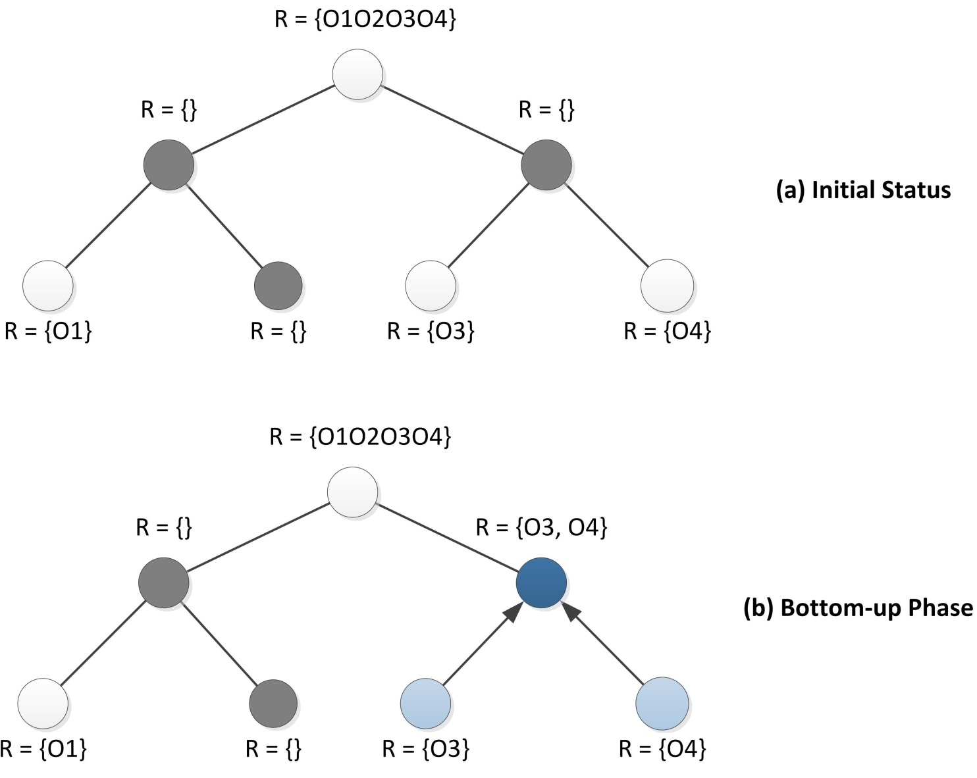
Failure Recovery
O1O2O3O4
O1O2
O3O4
O1
O2
O3
O4

Slide 19
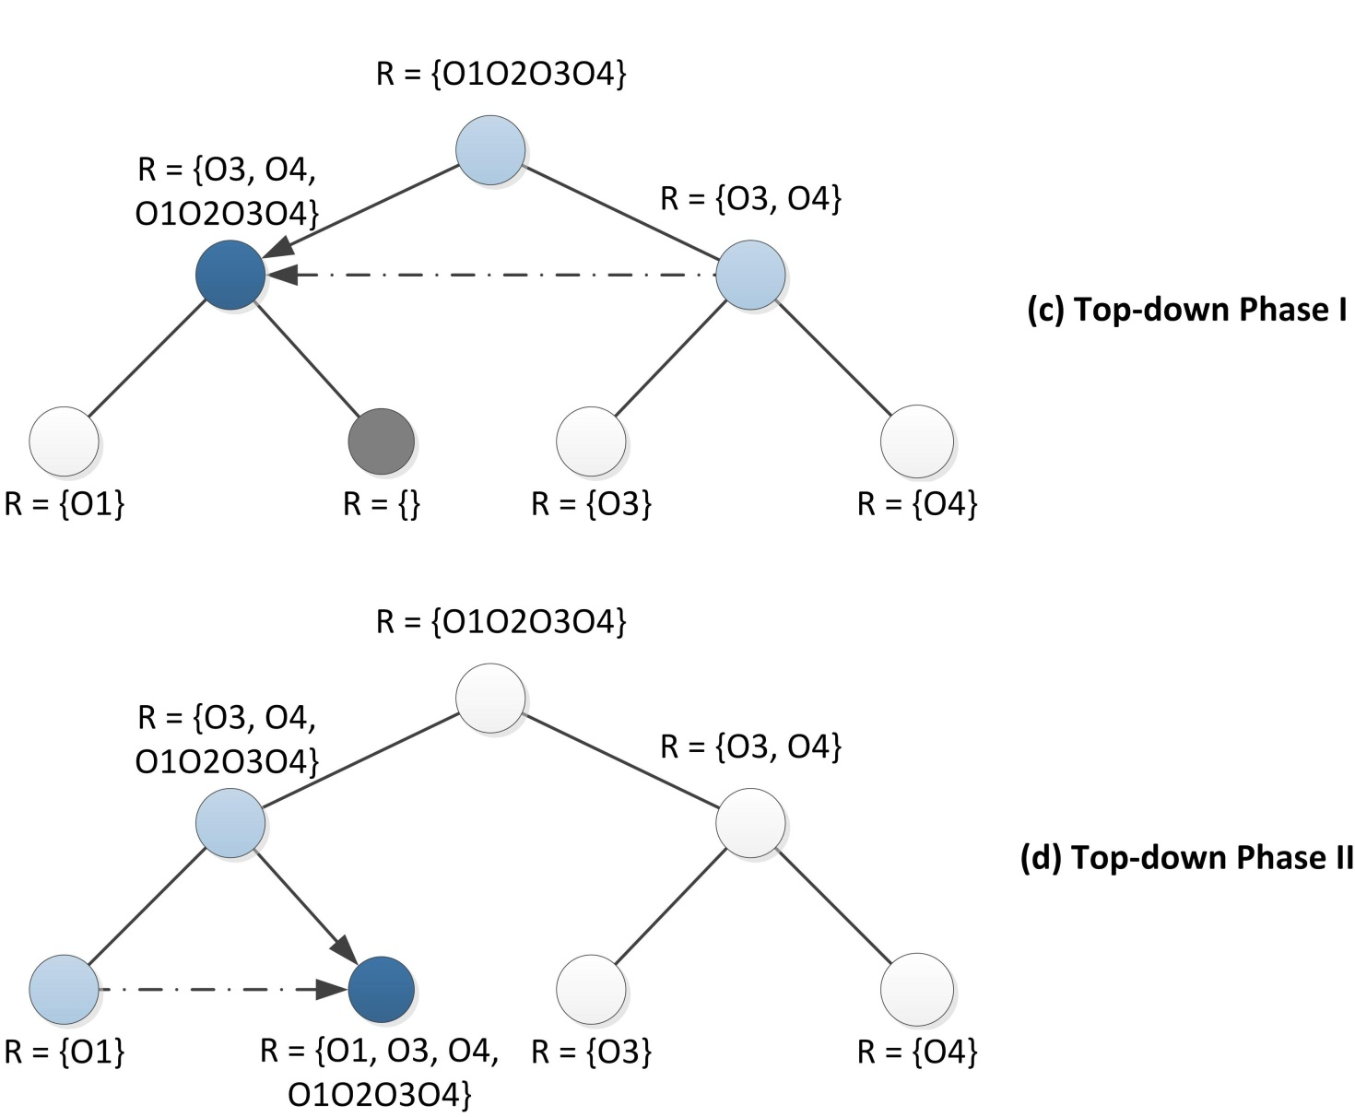
Failure Recovery (cont.)

Slide 20
Failure Recovery – Slave Side
The master assigns Slave 10 to restore missing part O3O4. O3 and O4 is desired for this recovery.
Recover: O3O4
<O3, Slave 9>
<O4, Slave 6>
Master
Slave 10
O3O4
Slave 9
Slave 6
O3
O4

Slide 21
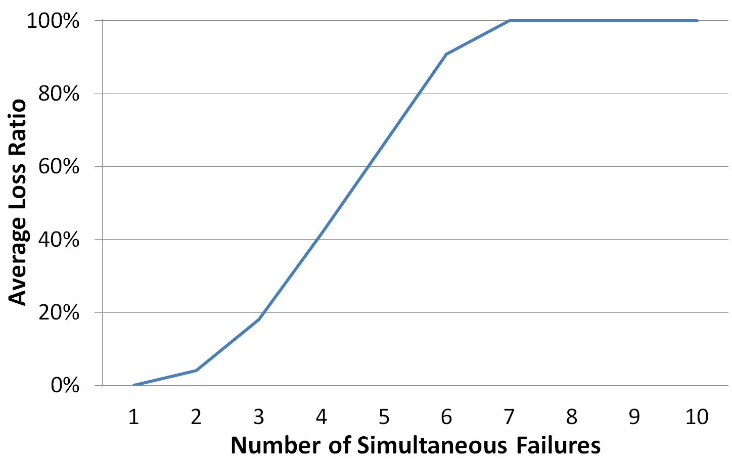
Experiments

Slide 22
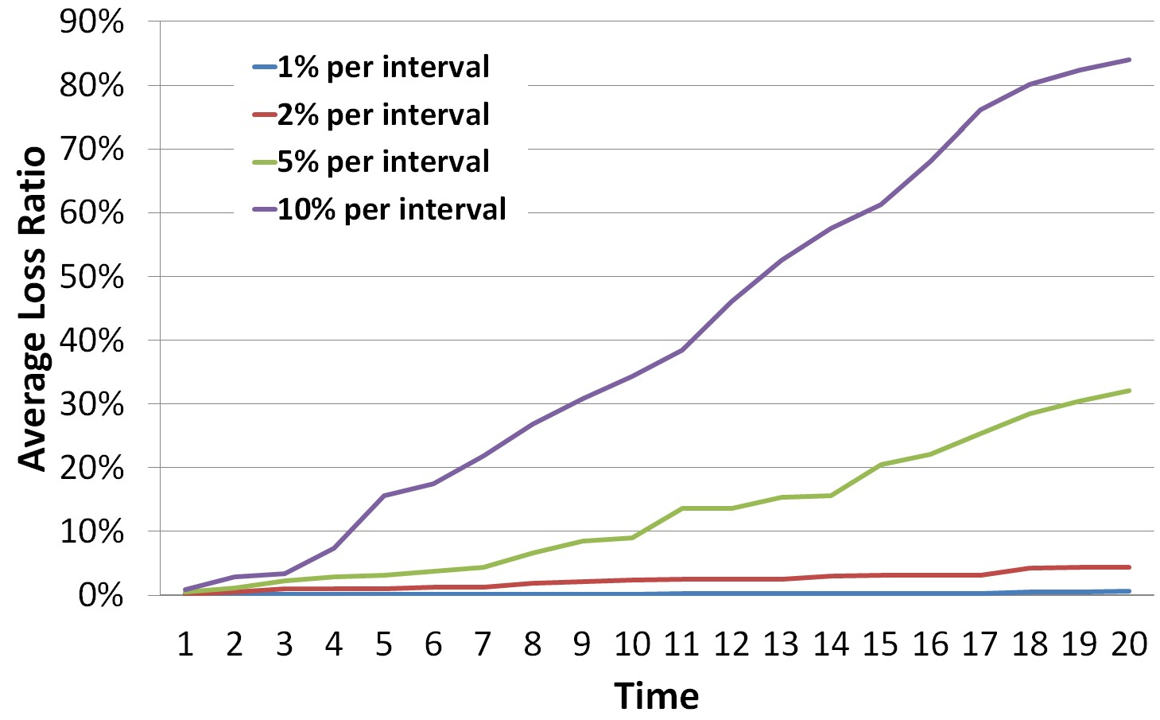
Experiments (cont.)

